Slide 1
Slaviša Đurđić
Wildlife strikes from 2000-2015 in the United States
Goal: Analysis of the Tableau “FAA Wildlife Strikes, 2015” public data sample dataset.
Instructions:
- Collect data by downloading the Excel file from https://public.tableau.com/app/learn/sample-data?qt-overview_resources=1#qt-overview_resources.
- Clean data, save as CSV, and use SQL queries to load the data to MySQL table(s).
- Execute some basic SQL queries.
- Build visuals in Tableau (https://public.tableau.com/app/profile/slavisadurdic/viz/StarWars_16943302674260/StarWars).
- Run multivariate logistic regression analysis in Python as well as time series analysis in Tableau.
Belgrade, September 2023

Slide 2
MySQL queries
USE data_analysis;
CREATE TABLE wildlife_strikes (
Airport_Code VARCHAR(4), Airport_Name VARCHAR(255),
Origin_State VARCHAR(50), Origin_State_Code VARCHAR(2),
Country VARCHAR(20), Aircraft_Type VARCHAR(20),
Aircraft_Number_of_engines INT, Collision_Date_and_Time DATETIME,
Time_of_day VARCHAR(50), Phase_of_flight VARCHAR(50),
Amount_of_damage VARCHAR(50), Impact_to_flight VARCHAR(50),
Indicated_Damage VARCHAR(50), Cost_Aircraft_time_out_of_service_hours INT,
Cost_Total_$ INT, Days FLOAT,
Feet_above_ground INT, Miles_from_airport INT,
Animal_Category VARCHAR(50), Species_Order VARCHAR(50),
Species_Group VARCHAR(255), Species VARCHAR(255),
Species_ID VARCHAR(10), Number_of_Strikes INT, Record_ID INT
);
LOAD DATA INFILE "faa_data_subset.csv " INTO TABLE wildlife_strikes FIELDS TERMINATED BY ',' ENCLOSED BY '“' LINES TERMINATED BY '\n' IGNORE 1 ROWS;

Slide 3
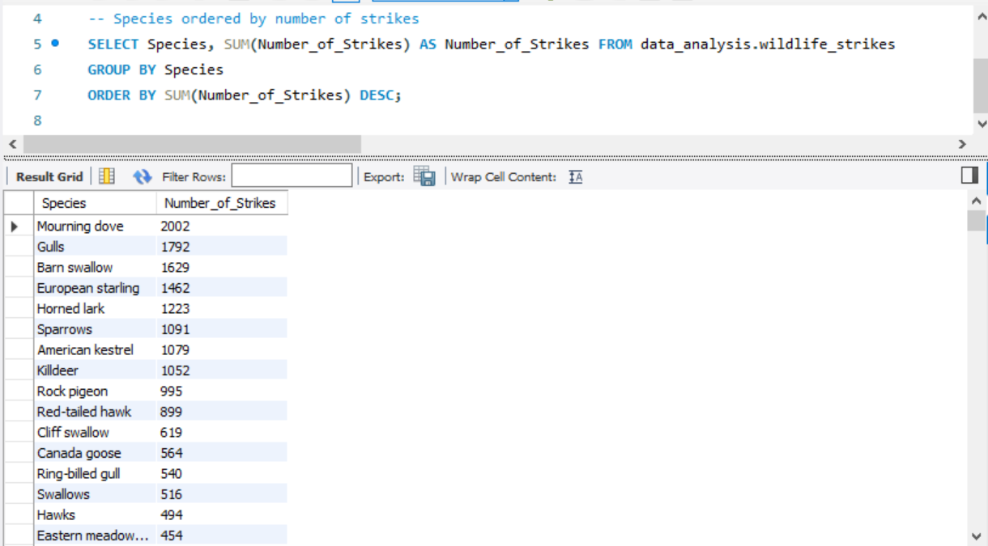
MySQL queries

Slide 4
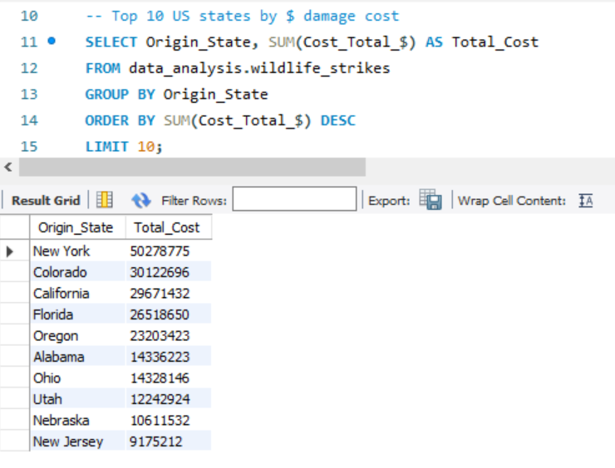
MySQL queries

Slide 5

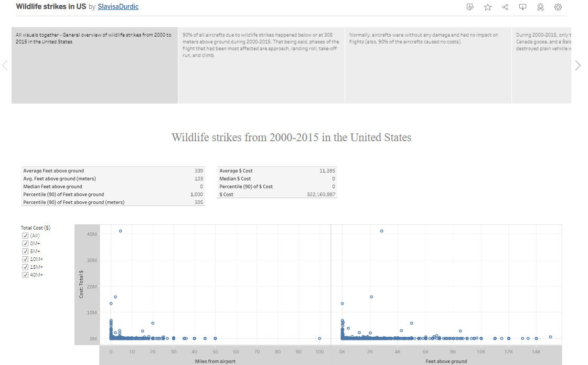

Slide 6
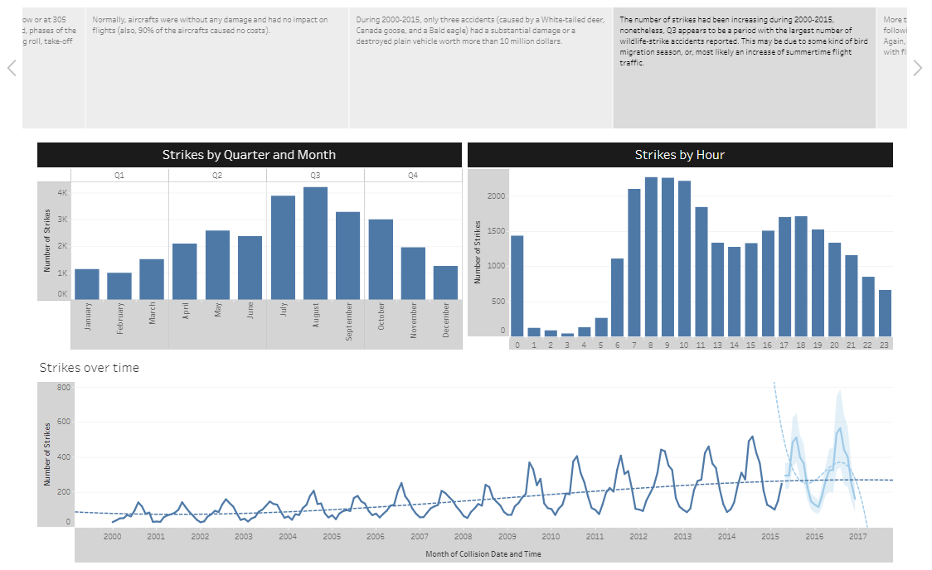

Slide 7
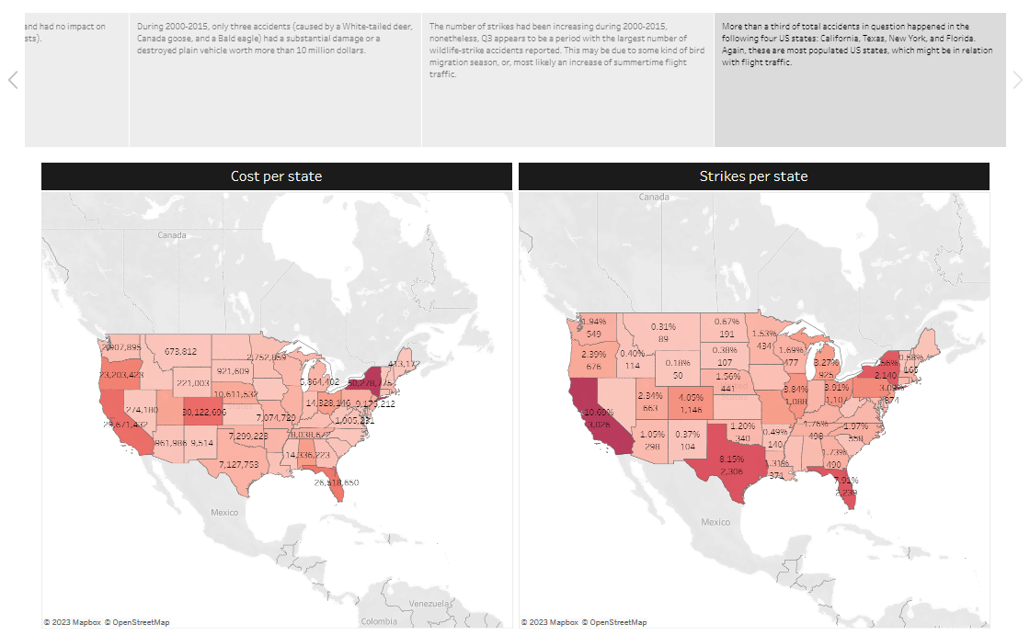

Slide 8
90% of all aircrafts due to wildlife strikes happened below or at 305 meters above ground during 2000-2015. That being said, phases of the flight that had been most affected are approach, landing roll, take-off run, and climb.
Normally, aircrafts were without any damage and had no impact on flights (also, 90% of the aircrafts caused no costs).
During the same period, only three accidents (caused by a White-tailed deer, Canada goose, and a Bald eagle) had a substantial damage or a destroyed plain vehicle worth more than 10 million dollars.
The number of strikes had been increasing during 2000-2015, nonetheless, Q3 appears to be a period with the largest number of wildlife-strike accidents reported. This may be due to some kind of bird migration season, or, most likely an increase of summertime flight traffic.
More than a third of total accidents in question happened in the following four US states: California, Texas, New York, and Florida. Again, these are most populated US states, which might be in relation with flight traffic.
Wildlife strikes Project Insights

